Slide 1
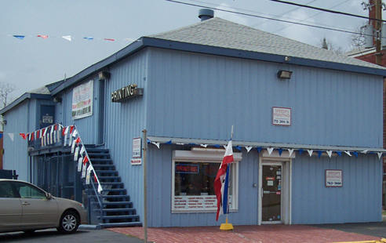
SPEEDY’S PRINTING
DIGITAL– PRINTING GRAPHICS – COPY CENTER
YOUR ONE STOP PRINT SHOP

Slide 2
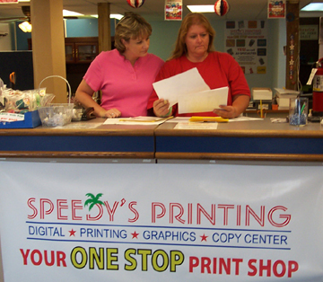
YOUR ONE STOP PRINT SHOP
OUR COMPANY MISSION STATEMENT:
“WE PROVIDE A SERVICE THAT PRODUCES HIGH QUALITY PRINTING & COPYING QUICKLY, ON TIME TO OUR CUSTOMER’S SATISFACTION.”

Slide 3
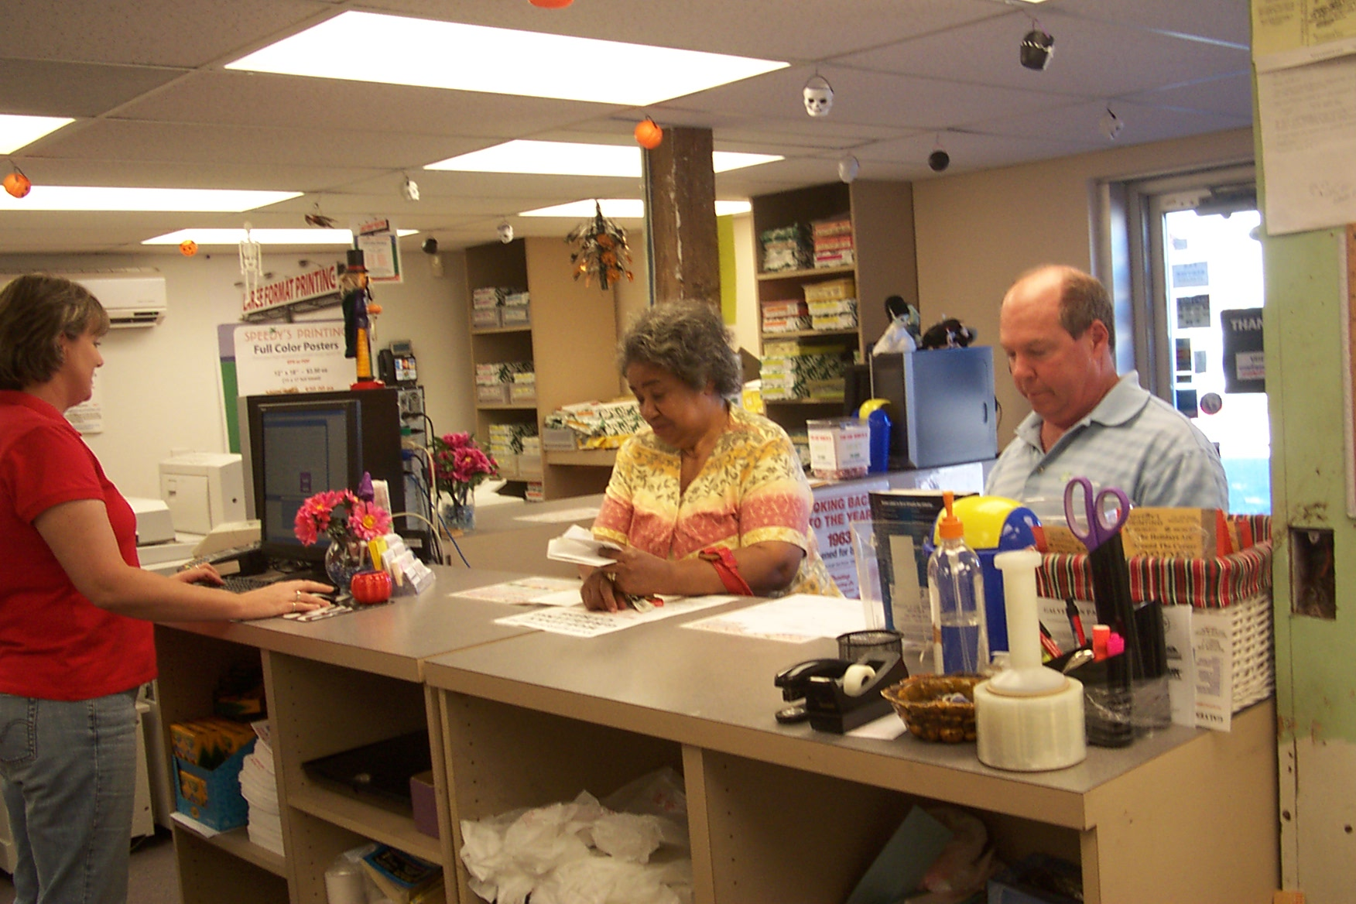

Slide 4
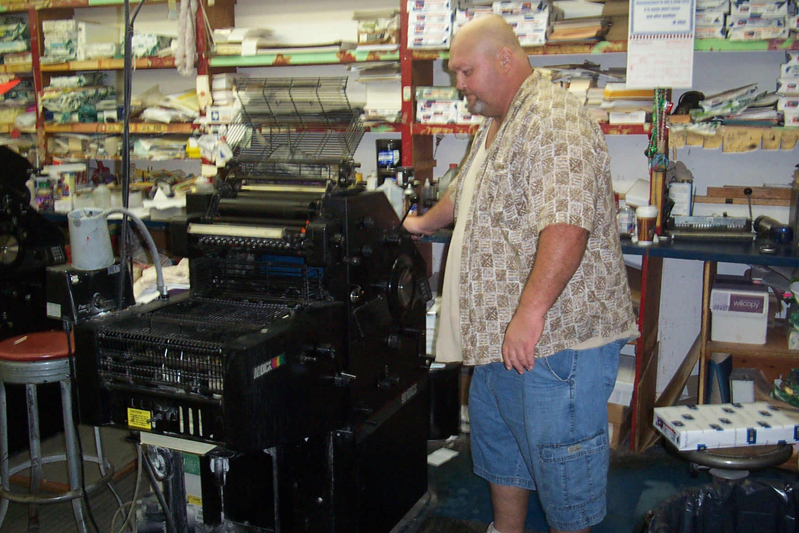
YOUR ONE STOP PRINT SHOP
HIGH QUALITY PRINTING
OUR PRESSES GIVE US THE CAPACITY TO HANDLE YOUR PRINTING NEEDS, NO MATTER HOW LARGE OR SMALL
QUALITY 1 & 2 COLOR PRINTING
LARGE SELECTION OF PAPER TO CHOOSE FROM
PMS COLORED INK MATCHING SYSTEM
SHORT AND LONG RUNS
REDUCTIONS & ENLARGEMENTS
QUICK TURNAROUND
11 X 17 LARGEST PRINTED SHEET SIZE

Slide 5
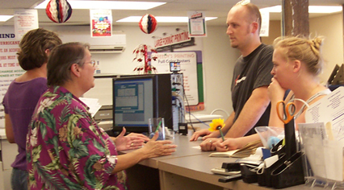

Slide 6
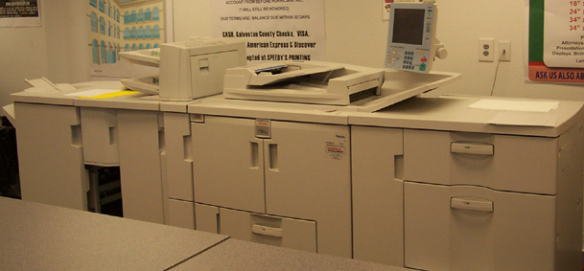
YOUR ONE STOP PRINT SHOP
HIGH VOLUME COPYING CENTER
WE ARE EQUIPPED WITH THE LATEST IN HIGH VOLUME COPIERS TO MEET ALL YOUR NEEDS.
8 ½ X 11 TO 11 X 17
ONE & TWO SIDED CAPABILITIES
WIDE RANGE OF PAPER STOCK CHOICES
AUTOMATIC COLLATING & STAPLING
TRANSPARENCIES
LABELS
REDUCTIONS & ENLARGEMENTS
SELF –SERVICE MACHINE AVAILABLE

Slide 7
YOUR ONE STOP PRINT SHOP
----- It Is Time To Order Your -----
PERSONALIZED HOLIDAY GREETING CARDS
24/7 Log on Anytime 24/7
www.speedysprinting.ccholiday.com
Place your order online, pay with a credit card & your cards will be drop-shipped directly to you.

Slide 8
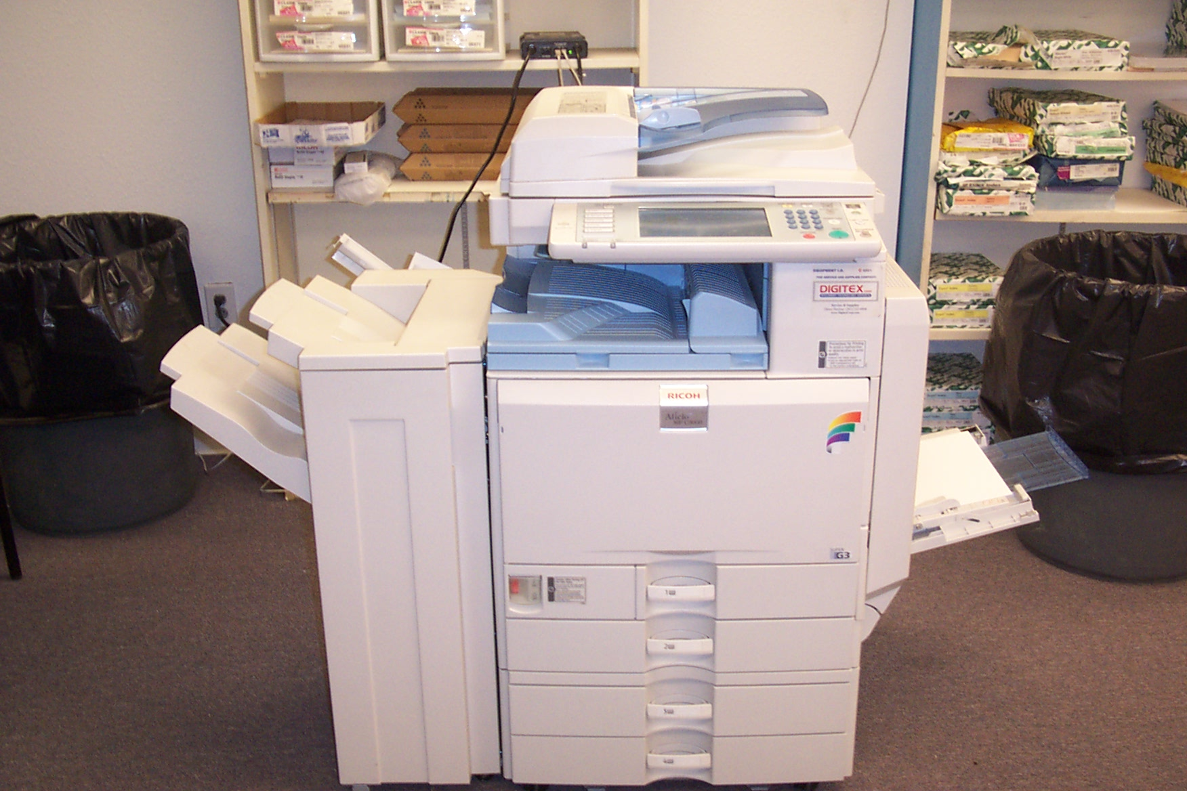
YOUR ONE STOP PRINT SHOP
COLOR COPYING
    WE ALSO HAVE THE LATEST IN DIGITAL COLOR COPIER TECHNOLOGY. WITH ITS COMPUTER INTERFACE, WE CAN PRODUCE OUTSTANDING COLOR COPIES FROM YOUR CD, FLASH DRIVE, OR JUMP DRIVE. THE POSSIBILLITIES ARE ENDLESS WITH A PRINTING AREA UP TO 11 X 17”! - SINGLE COLOR COPYING, LABELS, TRANSPARENCIES, AND PHOTO TRANSFERS ARE ALSO AVAILABLE.

Slide 9
SPEEDY’S PRINTING
--- NOW OFFERING ---
WEB SITE DESIGN SERVICE
WORLD CLASS WEB SITES
ARTWORK & LOGO DESIGN
ASK US TODAY!!!!

Slide 10
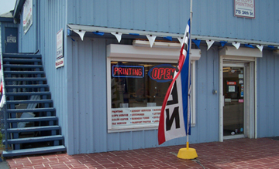

Slide 11
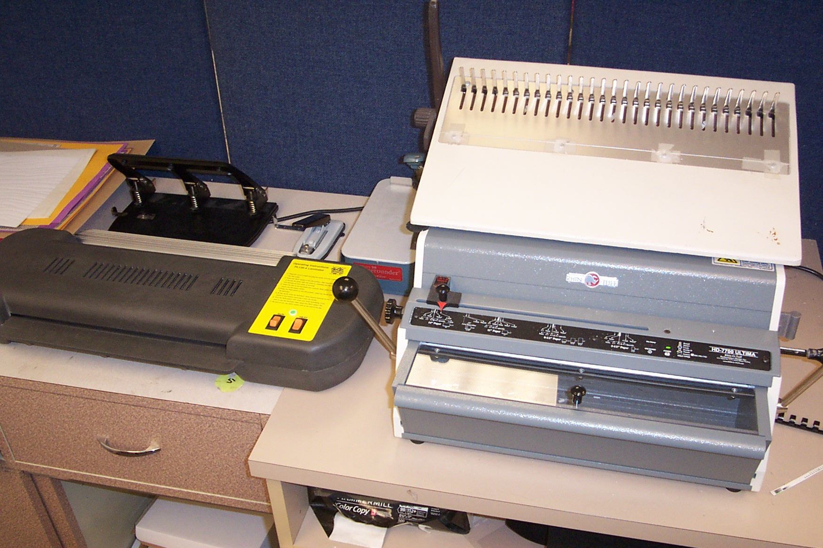
YOUR ONE STOP PRINT SHOP
FINISHING & BINDING
WE HAVE ALL THE TOOLS TO GIVE YOUR PROJECT THE PROFESSIONAL FINISH.
COLLATING – CUTTING – DRILLING – SCORING
PERFORATING – PLASTIC COMB – NUMBERING
SADDLE STITCHING – FOLDING – PADDING
STAPLING – DIE CUTS – GLUE PADDING

Slide 12
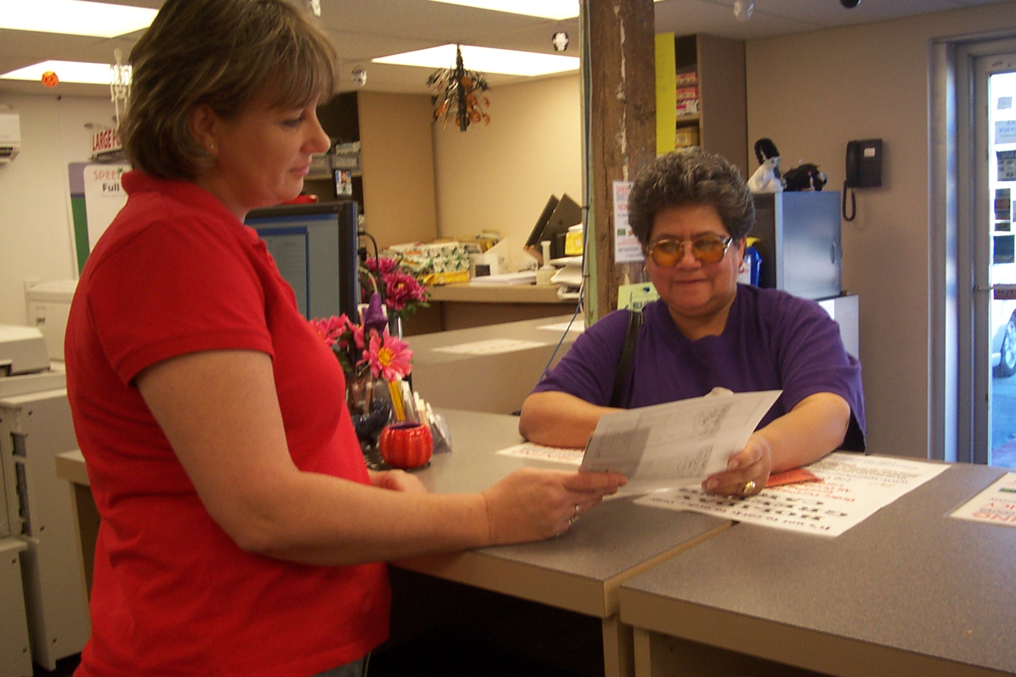

Slide 13
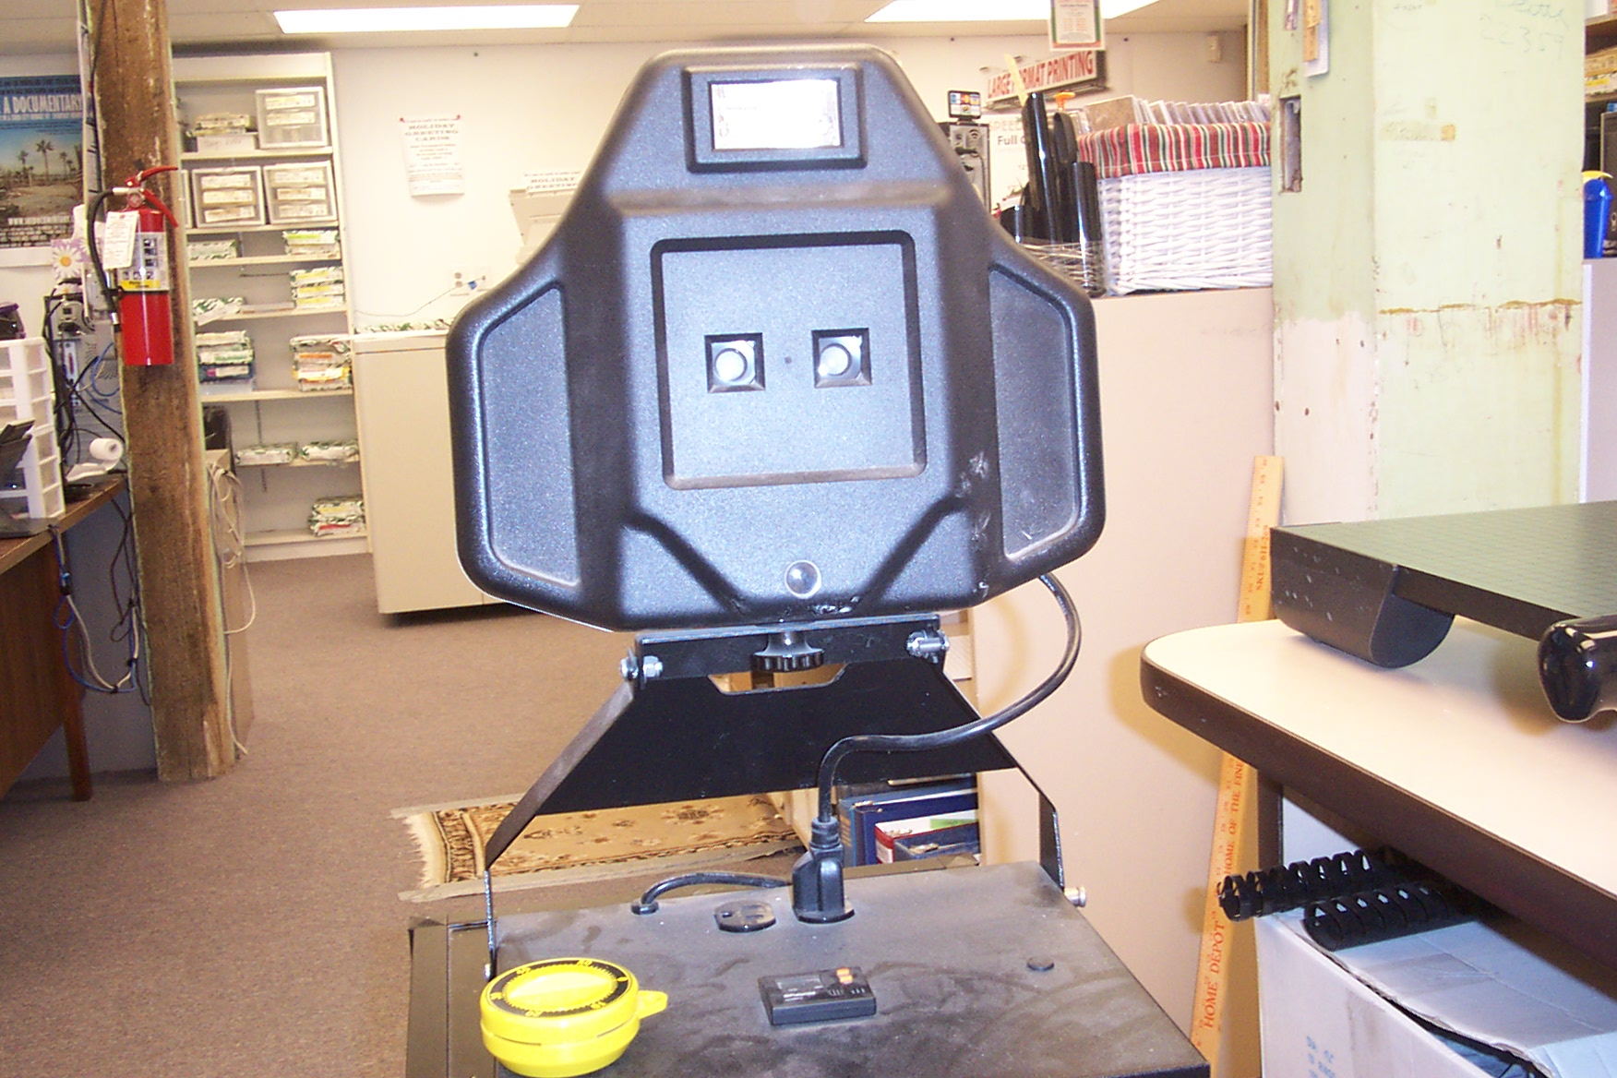
SPEEDY’S PRINTING
PASSPORT PHOTO’S
---WHILE YOU WAIT---
WE ONLY PROVIDE THE 2 PHOTO’S, WHICH MUST BE TAKEN WITH YOUR APPLICATION TO YOUR LOCAL POSTOFFICE, TO RECEIVE YOUR
USA PASSPORT

Slide 14
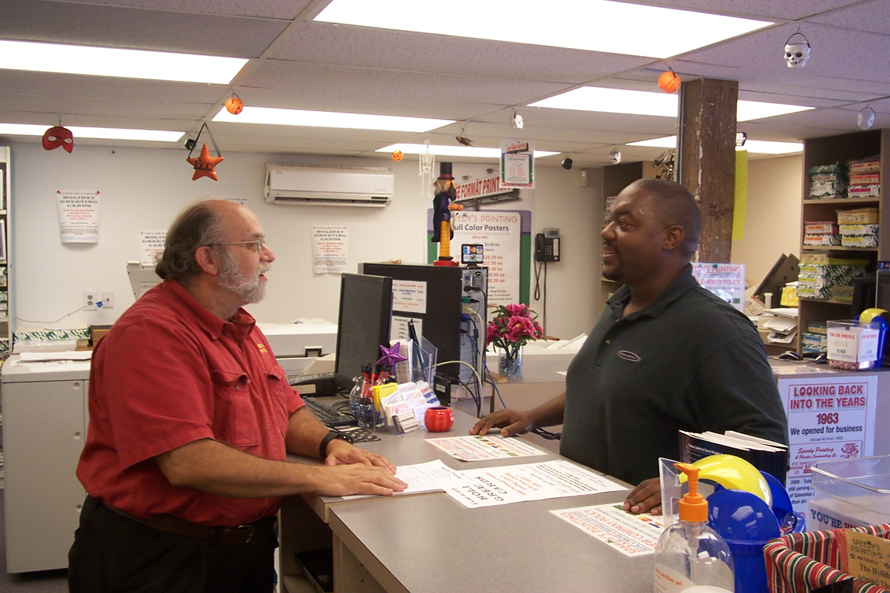

Slide 15
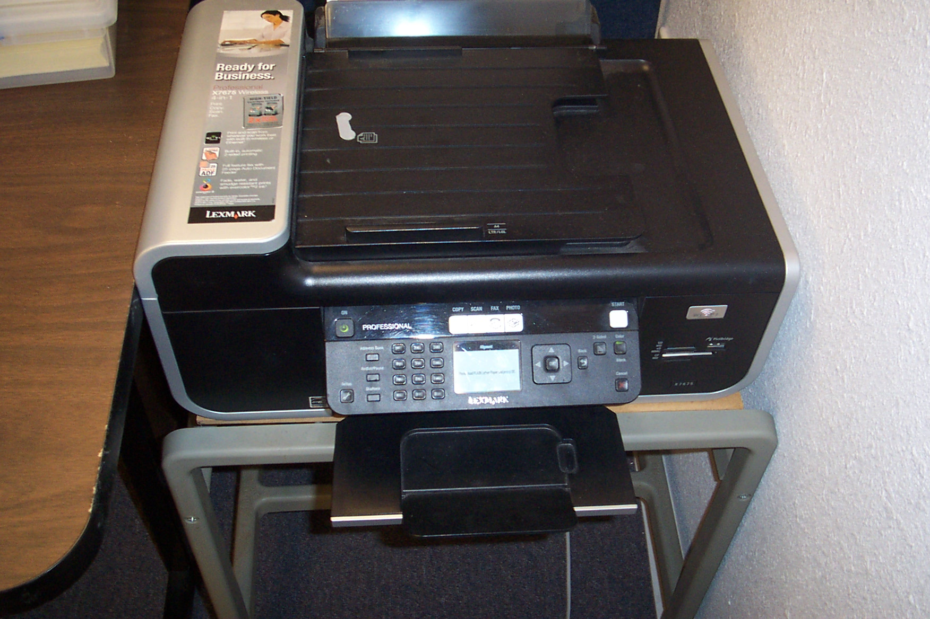
YOUR ONE STOP PRINT SHOP
FAX SERVICE
OUTGOING & INCOMING
WE ONLY SEND & RECEIVE IN THE USA
NO INTERNATIONAL FAXING
OUR FAX #: 409-763-8112 OPEN 24/7

Slide 16
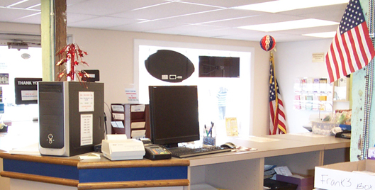

Slide 17
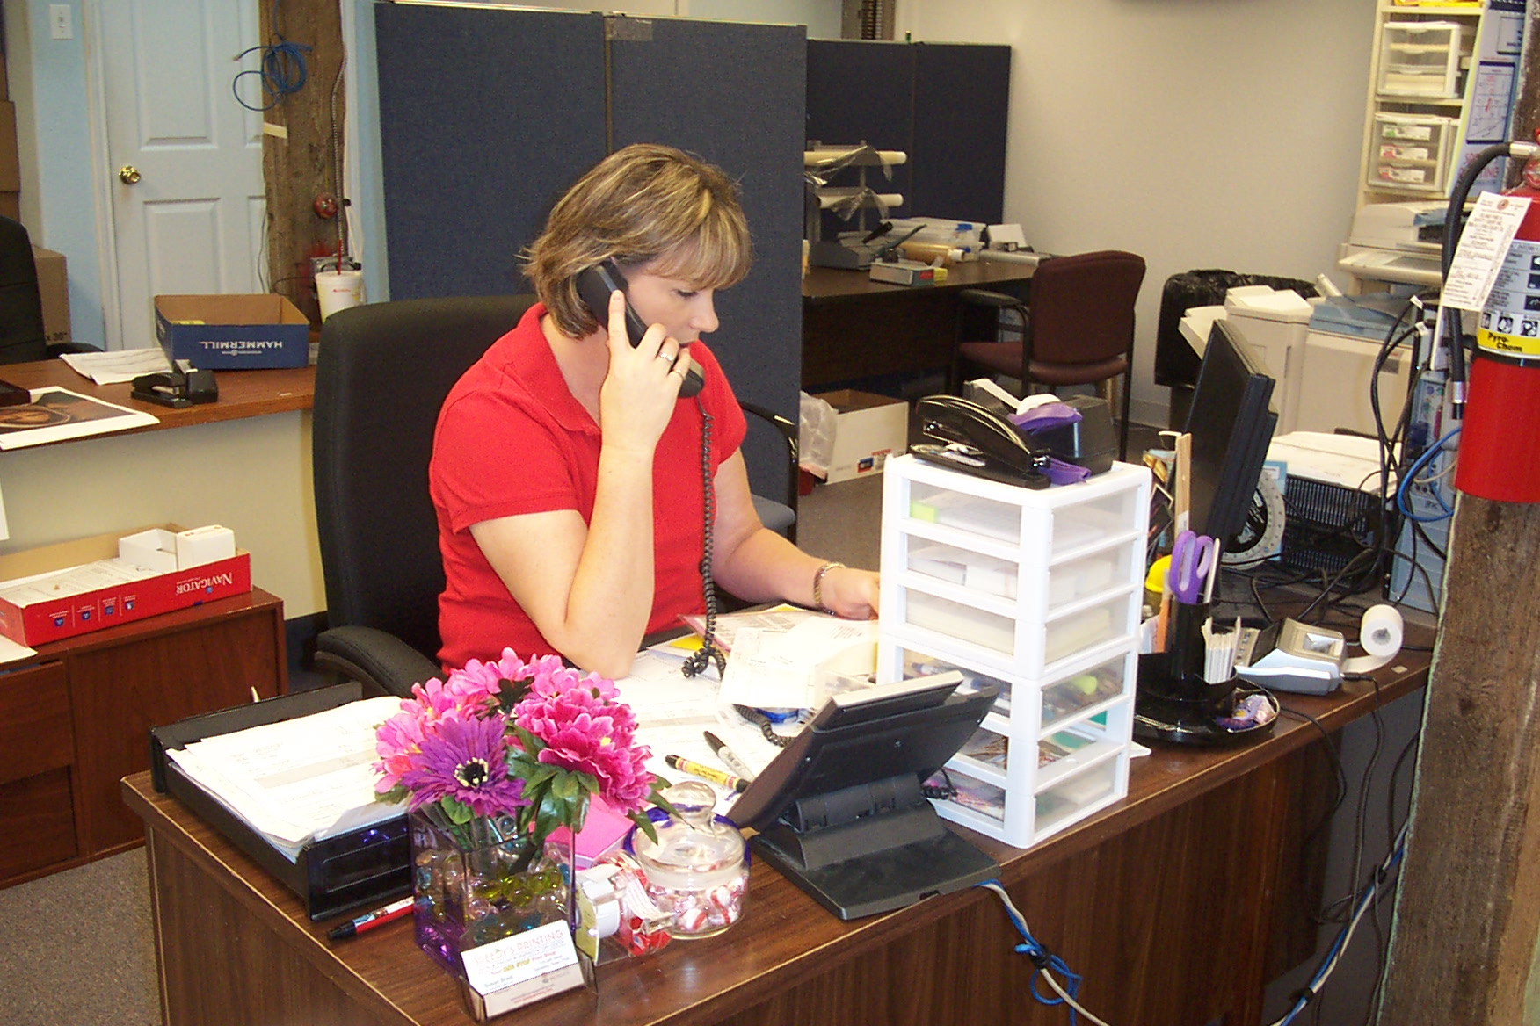
SPEEDY’S PRINTING
WE GUARANTEE
QUALITY
SERVICE
SATISFACTION
QUICK TURNAROUND
PROFESSIONALISM
COMPETITIVE PRICING
SELECTION

Slide 18
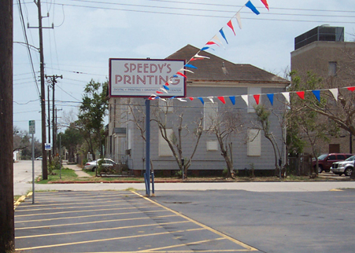

Slide 19
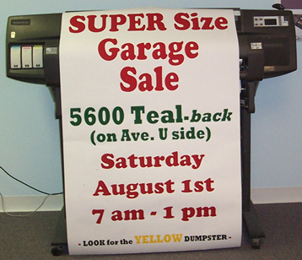
YOUR ONE STOP PRINT SHOP
FULL COLOR LARGE FORMAT PRINTING
WE FEATURE THE LATEST TECHNOLOGY IN EXTRA LARGE PRINTED
FULL COLOR POSTERS. 36” WIDE FULL COLOR OR BLACK INK FROM YOUR CD, JUMP DRIVE OR FLASH DRIVE
COME IN TODAY & LET US SHOW YOU !!!!

Slide 20
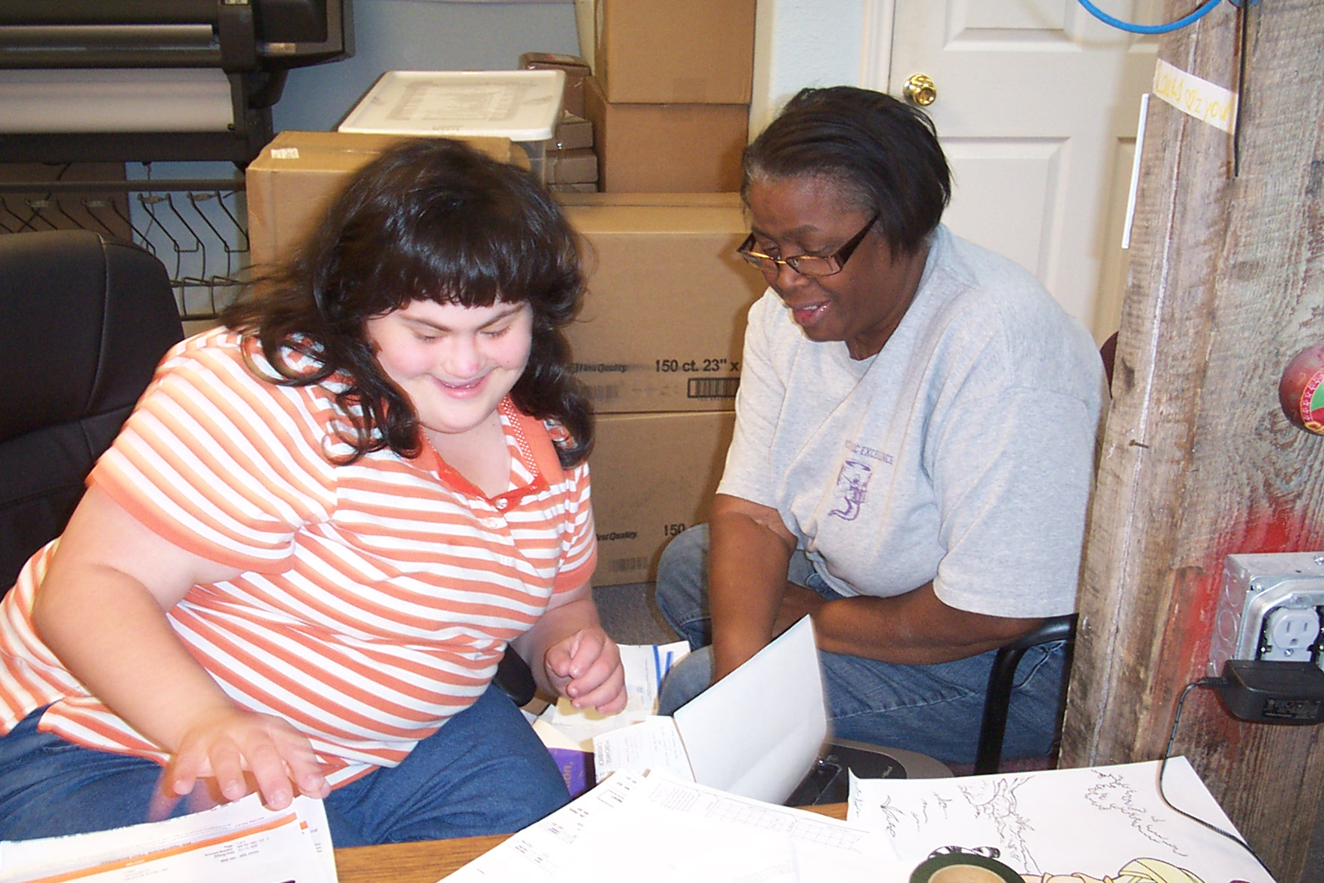

Slide 21
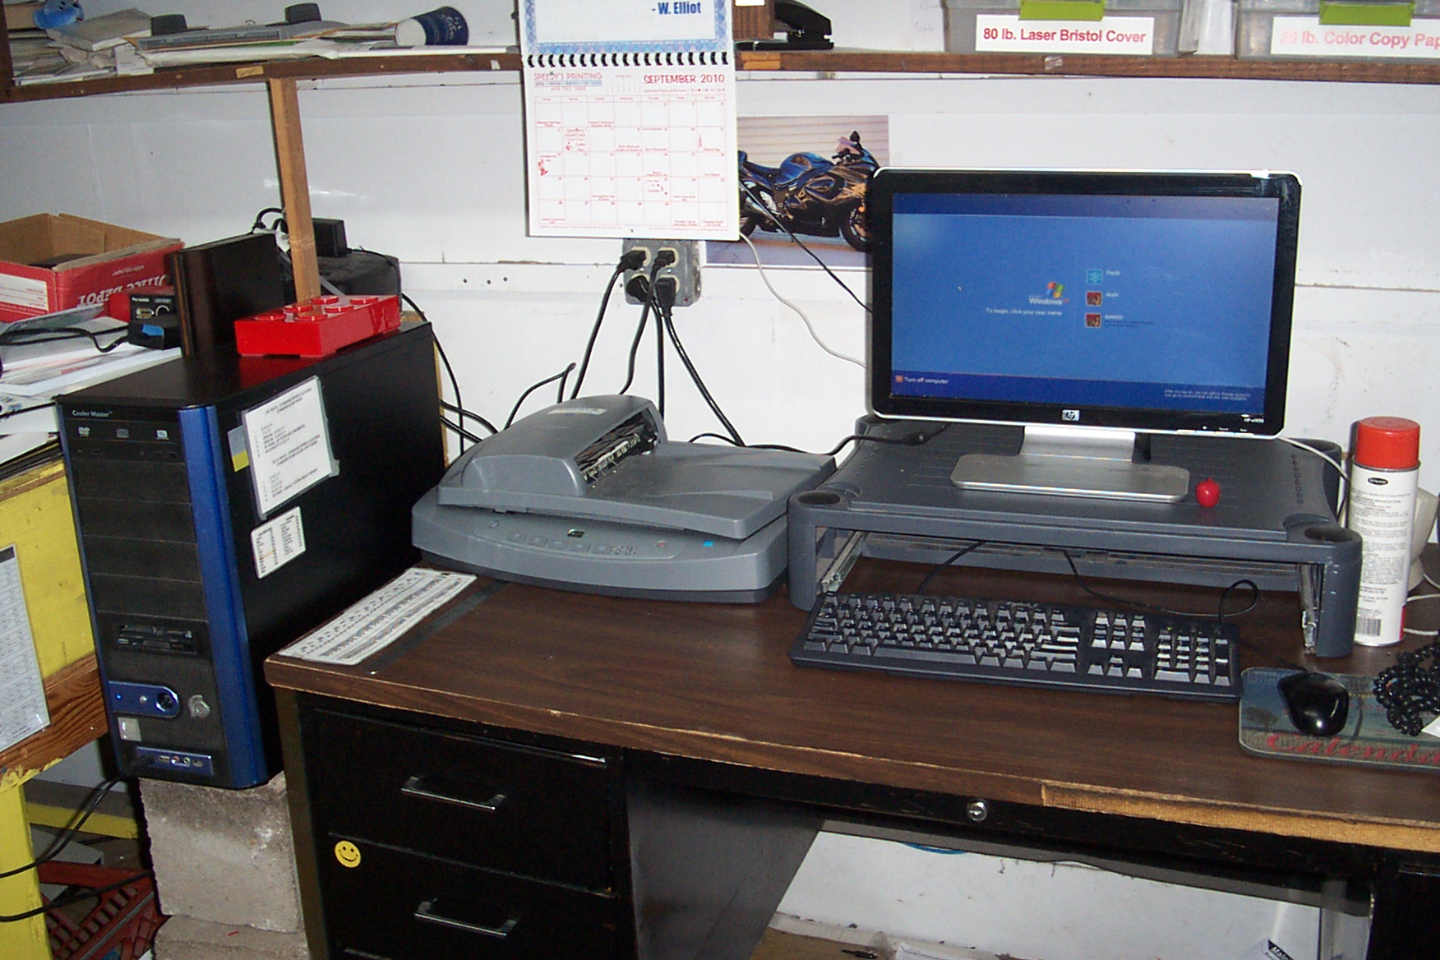
YOUR ONE STOP PRINT SHOP
DESKTOP PUBLISHING / TYPESETTING
OUR TYPESETTING DEPARTMENT IS OUTFITTED WITH STATE OF THE ART DESKTOP PUBLISHING COMPUTERS, USING A WIDE ARRAY OF SOFTWARE. LET US WORK WITH YOU ON ALL OF YOUR LAYOUT AND DESIGN NEEDS.
FILES ACCEPTED VIA WEB:
www. speedysprinting.com
Email: speedys@speedysprinting.com

Slide 22


Slide 23
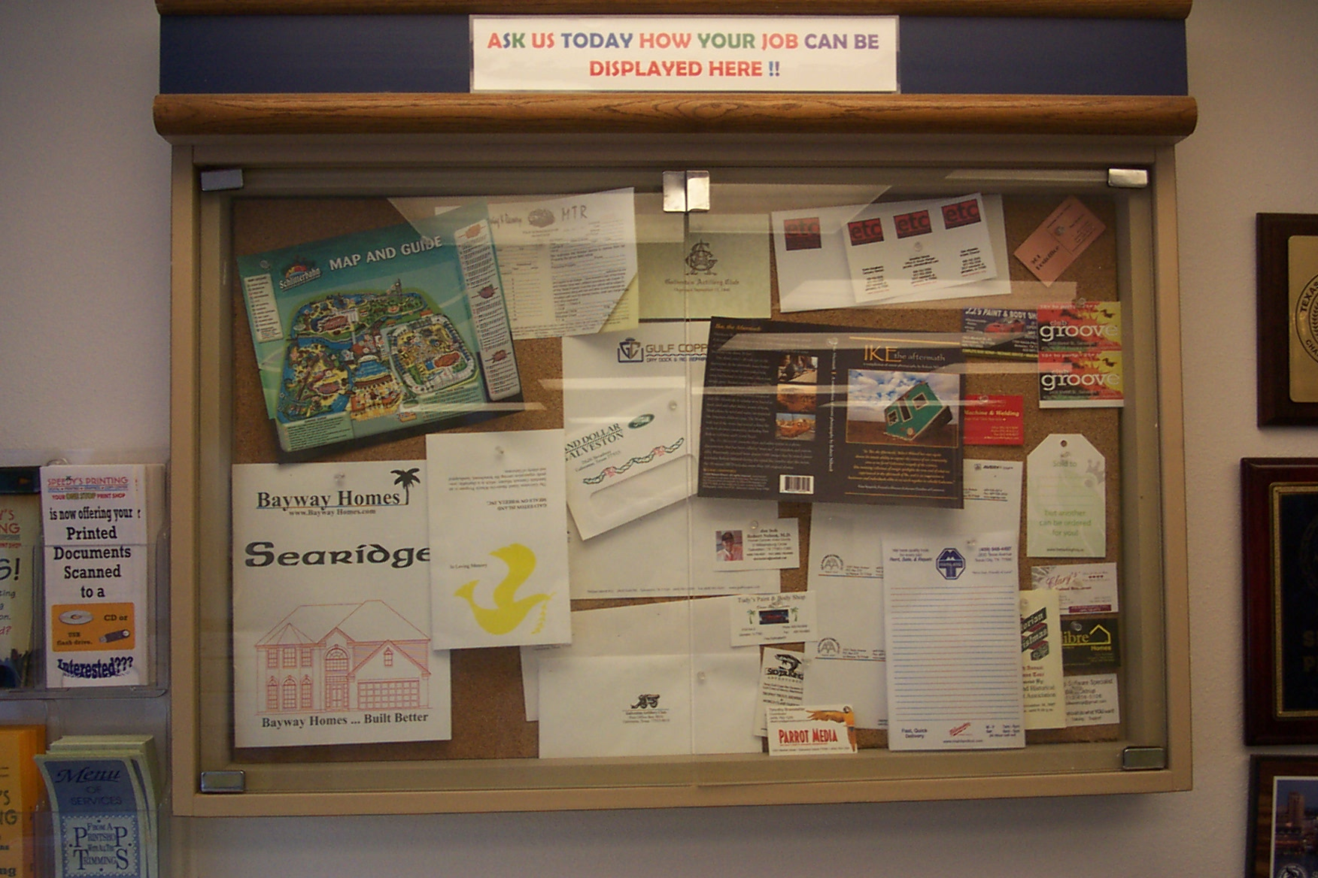

YOUR ONE STOP PRINT SHOP
SERVICE IS OUR BUSINESS
WE CAN PROVIDE:
LETTERHEADS – ENVELOPES – MEMO PADS – FLYERS - LABELS
INVITATIONS – REPORTS – RESUMES – BROCHURES – MENUS
MANUALS – POST CARDS – TICKETS – RAFFELS - REPORTS
BUSINESS CARDS – LEGAL BRIEFS – SALES LITERATURE
COUPONS - PASSPORT PHOTOS – FAX SERVICE – AD SPECIALITES
PRICE LISTS – BOOKLETS – NAME TAGS
PLUS MORE & MORE !!!!

Slide 24

SPEEDY’S PRINTING
OUR HOURS ARE:
9:00AM TO 5:00PM
MONDAY THRU FRIDAY
CLOSED SATURDAY & SUNDAY
OR BY APPOINTMENT ONLY
24/7 EMAIL: speedys@speedysprinting.com

Slide 25

SPEEDY’S PRINTING
OUR ADDRESS:
715-24TH STREET – GALVESTON, TEXAS 77550
PHONE: 409.763.1666 FAX: 409.763.8112
WEB: www.speedysprinting.com
E-MAIL: speedys@speedysprinting.com
We are located three blocks from Downtown Galveston
on 24th Street.

Slide 26
